Slide 1
Graphical Passwords
Aaron Cutright and Ryan Oshinsky

Slide 2
Definition and Purpose
An Authentication scheme that works by having the user interact with an image or set of images in a specific pattern to confirm their identity
The purpose is to increase memorability over a traditional alphanumeric password without sacrificing security
This could increase entropy in the areas that traditional passwords fail, mainly due to people choosing easy-to-remember strings that are just as easy to crack
Notes:
Recognition-based, identify selected images
and recall-based, recall created patterns

Slide 3
Common Graphical Password Schemes
Select Images from a group [4, 5]
Gesture Authentication
Free-form [1]
Grid based [8]
Passpoints [2]
Cued click points [6]

Slide 4
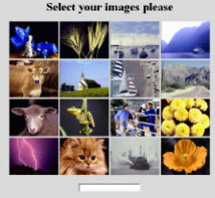
Selecting Images from a Group
De Angeli et al., 2005
User selects a number of images from a group
Interference of similar images can cause issues with visual memory
Entropy depends on the number of images in the database and number of images selected

Slide 5
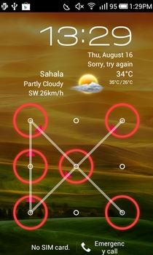
Grid Based Gesture
User creates a pattern on a grid of fixed points
Easy to recreate pattern for log in recognition,password is dependent on fixed points
Entropy cannot easily be increased with the size of the grid
Users tend to choose non-complex password (like text-based)
Guessability decreases with size of grid
Beyond 4x4 grid does not create much change, but ease of entering password decreases since contact points become more dense

Slide 6
Free-Form Gesture
Password is generated from a user drawn gesture
“Free-form gesture passwords are faster to perform, faster to create, faster to log in, and have strong log-in success rates” compared to text passwords
Entropy is related to number of cells on screen and number of points in gesture
Mainly usable only on mobile devices or touch screens, difficult with mouse
Common shapes or patterns can be easy to predict

Slide 7
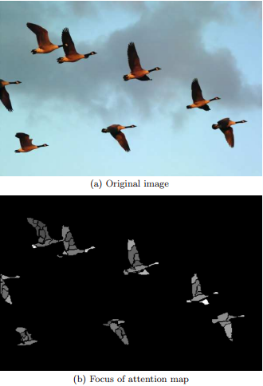
PassPoints
(Dirik et al.,2007) “Modeling user choice in the PassPoints graphical password scheme”
Password defined by a sequence of points selected by a user over an image
Can be easy to remember and reproduce
Easy to model user choice and the entropy of click points
Vulnerable to dictionary attacks based on Focus of Attention (FOA) maps
Can use model of user choice entropy to select suitable underlying images

Slide 8
Cued Click Points
Password is determined from users clicking on a point per image for a series of images
The next image is determined by the click location on the last image
Greater memorability over passpoints because only one point needed to be remembered per image
Requires more work for attackers, need to acquire image sets for each user and do hotspot analysis on entire image set

Slide 9
Technique | Process | Memorability | Password Space | Attack methods
Text based | Type in password | Longer random passwords can be difficult | 94^K | Dictionary attack, brute force search, guess, spyware, etc.
Select images from a group | Select multiple images from a group | More memorable than text | N choose K N = group, K = images | Brute force search, guess
Grid Based Gesture | Draw something on a 2D grid | Depends on what users draw. User studies showed the drawing sequence is hard to remember | Larger than text based, but decreases significantly with fewer strokes for a fixed password length | Dictionary attack
Free-form gesture | Draw something on top of an image or canvas | Depends on what users draw | N! N = precision required | Guess, dictionary attack
PassPoints | Click on several locations of a picture in the right sequence | Depends on what users draw | N^K N =pixels , K =clicks | Guess, brute force search, FOA maps
Cued Click Points | Click on a single point in a series of images | Easier to remember than passpoints | N^K N=grid-px, K=clicks | Guess, brute force search, FOA maps

Slide 10
Our Implementation
d

Slide 11
Sources
[1] Yang Y, Clark G. D., Lindqvist J., Oulasvirta A. 2016. Free-Form Gesture Authentication in the Wild. CHI’16, May 07 - 12, 2016, San Jose, CA, USA. http://winlab.rutgers.edu/~janne/CHI16-ESMgestures.pdf
[2] Dirik A. E., Memon N., Birget J. 2007. Modeling user choice in the PassPoints graphical password scheme. https://cups.cs.cmu.edu/soups/2007/proceedings/p20_dirik.pdf
[3] Gyorffy J. C.,Tappenden A. F., Miller J. 2011.Token-based graphical password authentication. International Journal of Information Security. http://link.springer.com/article/10.1007/s10207-011-0147-0
[4] Davis D., Monrose F., Reiter M. K. 2004. On User Choice in Graphical Password Schemes https://users.ece.cmu.edu/~reiter/papers/2004/usenix2.pdf
[5] De Angeli A., Coventry L., Johnson G., Coutts M. 2003. USABILITY AND USER AUTHENTICATION: PICTORIAL PASSWORDS VS. PIN. Contemporary Ergonomics, Taylor & Francis pp. 253-258 http://www.antonella_de_angeli.talktalk.net/files/Pdf/USABILITY%20AND%20USER%20AUTHENTICATION%20PICTORIAL%20PASSWORDS%20VS%20PIN.pdf
[6] Chiasson S., Van Oorschot P. C., Biddle R. 2007. Graphical password authentication using cued click points. ESORICS'07 Proceedings of the 12th European conference on Research in Computer Security. 359 -374. http://dl.acm.org/citation.cfm?id=2393880&preflayout=flat https://www.ccsl.carleton.ca/paper-archive/chiasson-esorics07.pdf
[7] Suo X., Zhu Y., Owen G. S. 2005. Graphical Passwords: A Survey. Proceedings of the 21st Annual Computer Security Applications Conference (ACSAC 2005) . http://ieeexplore.ieee.org/stamp/stamp.jsp?tp=&arnumber=1565273
[8] Aviv A. J., Budzitowski D., Kuber R. 2015. Is Bigger Better? Comparing User-Generated Passwords on 3x3 vs. 4x4 Grid Sizes for Android's Pattern Unlock. ACSAC 2015 Proceedings of the 31st Annual Computer Security Applications Conference. DOI = http://dl.acm.org/citation.cfm?doid=2818000.2818014 http://www.usna.edu/Users/cs/aviv/papers/aviv-acasc15.pdf

